Slide 1
Chapter 8 Address Resolution Protocol (ARP)

Slide 2
Outline
Address Mapping
The ARP Protocol
ATMARP
ARP Package
The McGraw-Hill Companies, Inc., 2000

Slide 3
Logical Addresses
The hosts and routers are recognized at the network level by their logical addresses
A logical address is an internet address
Called a logical address because it is usually implemented in software
The logical addresses in the TCP/IP are called IP address and are 32 bits long

Slide 4
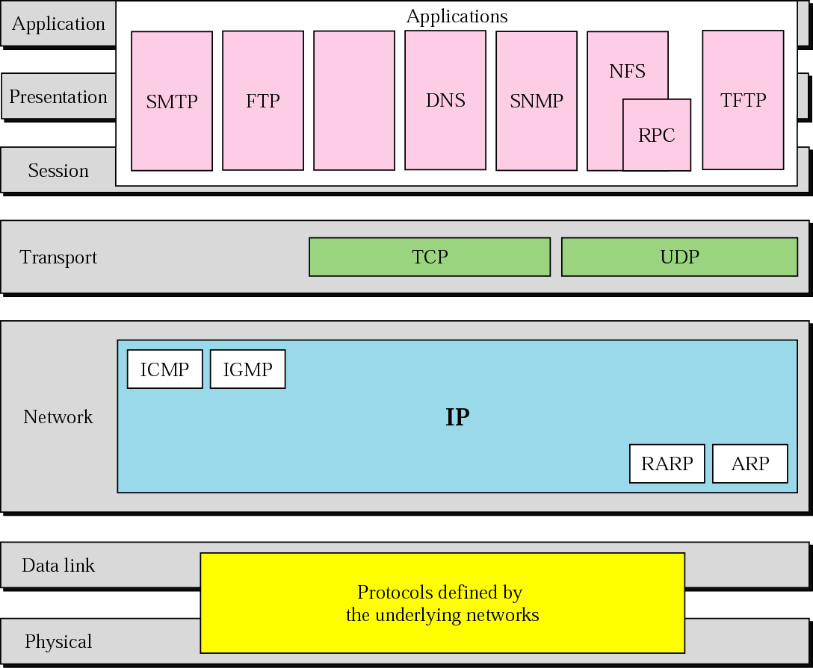
Figure 2-15
TCP/IP and OSI Model
The McGraw-Hill Companies, Inc., 2000

Slide 5
Physical Address
However, hosts/routers are recognized at the physical layer by their physical address
A physical address is an local address
Called a physical address because it is usually implemented in hardware
Examples
48-bit MAC addresses in Ethernet

Slide 6
Address Mapping
We need both the physical address and the logical address for packet delivery
Thus, we need to be able to map a logical address to its corresponding physical address and vice versa
Solutions
Static mapping
Dynamic mapping

Slide 7
Static Mapping
Create a table that associates a logical address with a physical address and store in each machine
However, physical addresses may change
A machine could change its NIC resulting in a new physical address
In some LANs, such as LocalTalk, the physical address changes every time the computer is turned on
A mobile station can move from one physical network to another, resulting in a change in its physical address

Slide 8
Dynamic Mapping
Use a protocol to find another address
ARP: Address Resolution Protocol
Map a logical address to a physical address
RARP: Reverse Address Resolution Protocol
Map a physical address to a logical address
Have been replaced by other protocols and therefore deprecated

Slide 9
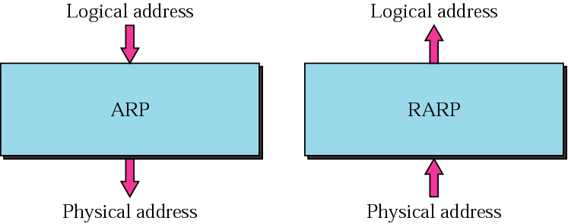
Figure 7-1
ARP and RARP
The McGraw-Hill Companies, Inc., 2000

Slide 10
Outline
The McGraw-Hill Companies, Inc., 2000
Address Mapping
The ARP Protocol
ATMARP
ARP Package

Slide 11
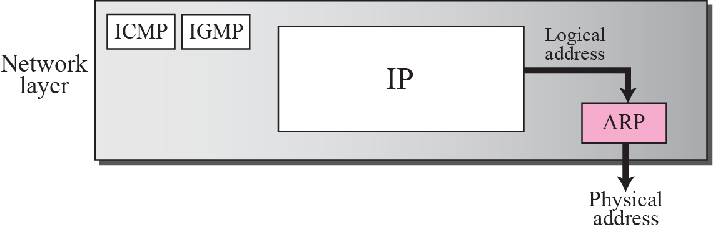
Position of ARP in TCP/IP Protocol Suite

Slide 12
ARP Operation
To find the physical address of another host or router on its network
Send an ARP request message
ARP request message
The physical address of the sender
The IP address of the sender
The physical address of the receiver is 0s
The IP address of the receiver

Slide 13
ARP Operation (Cont.)
Then, ARP request message is broadcast by the physical layer
For example: in Ethernet, MAC header’s destination address is all 1s (broadcast address)
Received by every station on the physical network
The intended recipient send back an ARP reply message
ARP reply message packet is unicast

Slide 14
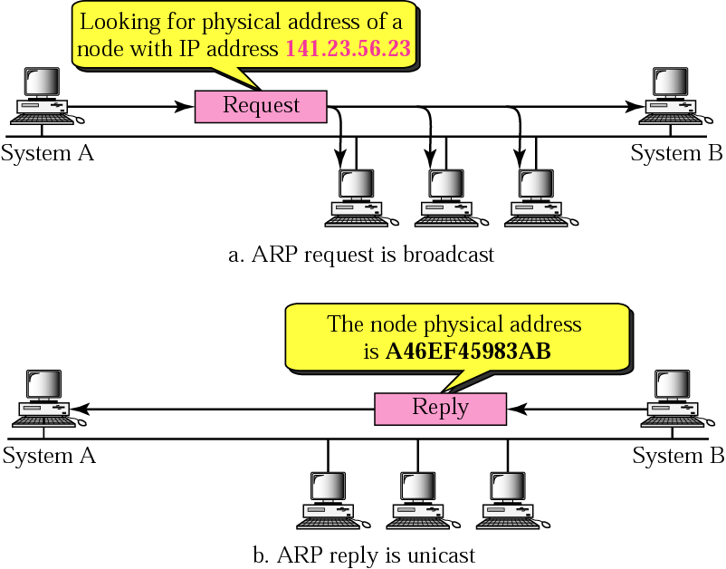
Figure 7-3
ARP Operation
The McGraw-Hill Companies, Inc., 2000

Slide 15
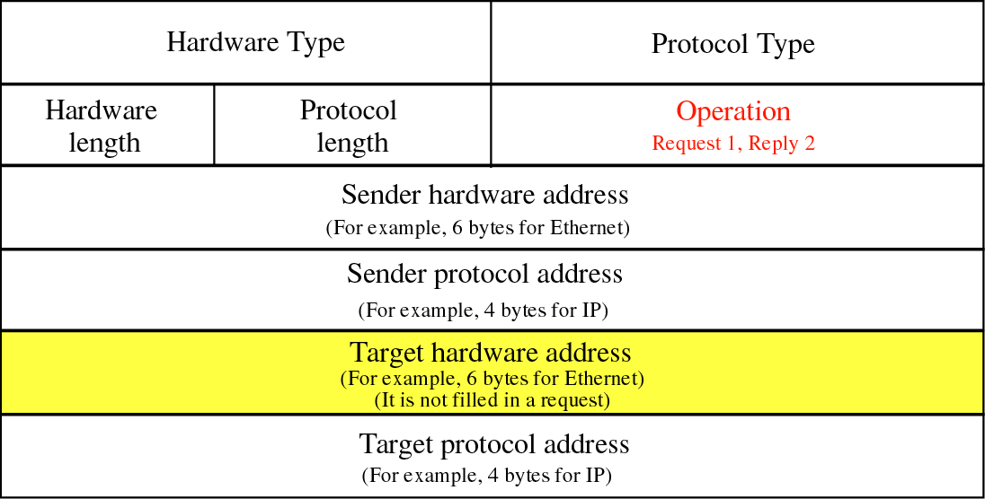
Figure 7-4
ARP Packet Format
The McGraw-Hill Companies, Inc., 2000

Slide 16
Packet Format
HTYPE (Hardware type)
16-bit field defining the underlying type of the network
Ethernet is given the type 1
ARP can be used on any physical network
PTYPE (Protocol type)
16-bit field defining the protocol
IPv4 is 0800₁₆
ARP can be used with any higher-level protocol

Slide 17
Packet Format (Cont.)
HLEN (Hardware length)
8-bit field defining the length of the physical address in bytes
Ethernet has the value of 6
PLEN (Protocol length)
8-bit field defining the length of the logical address in bytes
IPv4 has the value of 4
OPER (Operation)
16-bit field defining the type of packet
(1) = ARP request, (2) = ARP reply

Slide 18
Packet Format (Cont.)
SHA (Sender hardware address)
A variable-length field defining the physical address of the sender
SPA (Sender protocol address)
A variable-length field defining the logical address of the sender

Slide 19
Packet Format (Cont.)
THA (Target hardware address)
A variable-length field defining the physical address of the target
For an ARP request operation packet
This field is all 0s
TPA (Target protocol address)
A variable-length field defining the logical address of the target

Slide 20
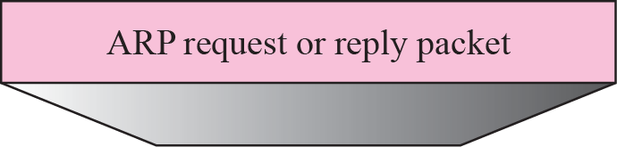
Figure 7-5
Encapsulation of ARP Packet
An ARP packet is encapsulated directly into a data link frame
Type field indicates that the data carried by the frame is an ARP packet
The McGraw-Hill Companies, Inc., 2000

Slide 21
Four Cases to Use ARP
Case 1: The sender is a host and wants to send a packet to another host on the same network
Use ARP to find another host’s physical address
Case 2: The sender is a host and wants to send a packet to another host on another network
Sender looks at its routing table
Find the IP address of the next hop (router) for this destination
Use ARP to find the router’s physical address

Slide 22
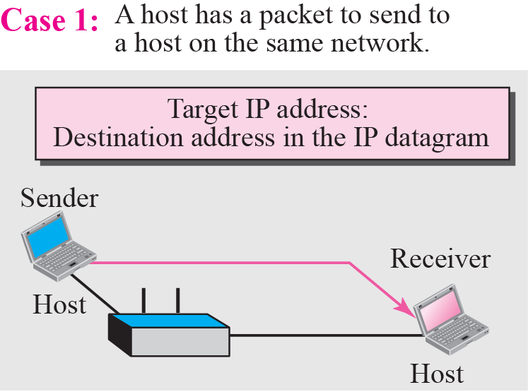
Figure 7-6:a
Four Cases Using ARP: Case 1
The McGraw-Hill Companies, Inc., 2000

Slide 23
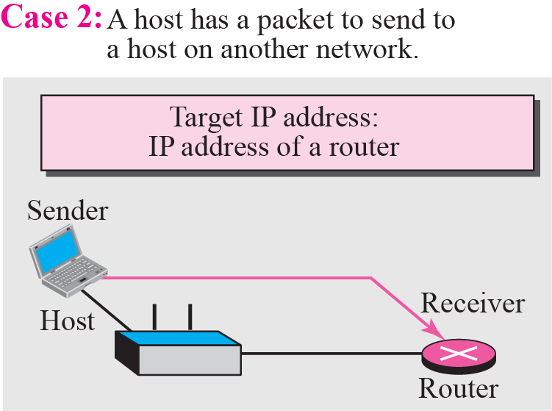
Figure 7-6:b
Four Cases Using ARP: Case 2
The McGraw-Hill Companies, Inc., 2000

Slide 24
Four Cases to Use ARP (Cont.)
Case 3: the sender is a router and received a datagram destined for a host on another network
Router check its routing table
Find the IP address of the next router
Use ARP to find the next router’s physical address
Case 4: the sender is a router that has received a datagram destined for a host in the same network
Use ARP to find this host’s physical address

Slide 25
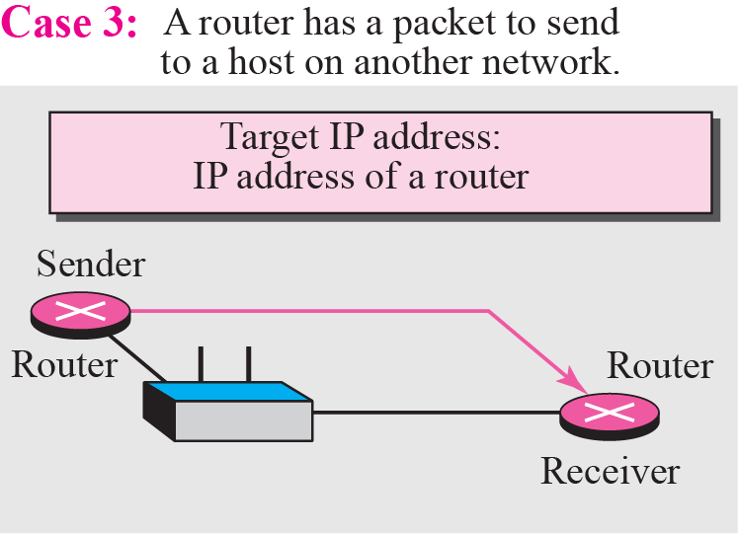
Figure 7-6:c
Four Cases Using ARP: Case 3
The McGraw-Hill Companies, Inc., 2000

Slide 26
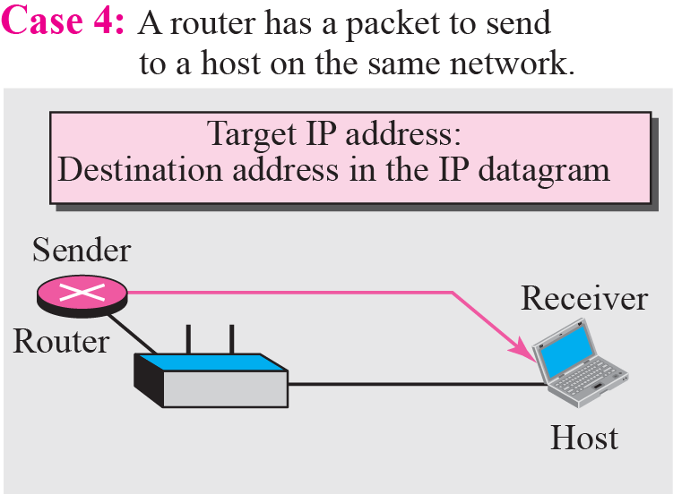
Figure 7-6:d
Four Cases Using ARP: Case 4
The McGraw-Hill Companies, Inc., 2000

Slide 27
Example 8.1
A host with IP address 130.23.43.20 and physical address B2:34:55:10:22:10
Another host with IP address 130.23.43.25 and physical address A4:6E:F4:59:83:AB.
The two hosts are on the same Ethernet network
Show the ARP request and reply packets encapsulated in Ethernet frames

Slide 28
Solution
Next Figure shows the ARP request and reply packets
Note that
The IP addresses are shown in hexadecimal

Slide 29
Figure 7-4
ARP Packet
The McGraw-Hill Companies, Inc., 2000

Slide 30
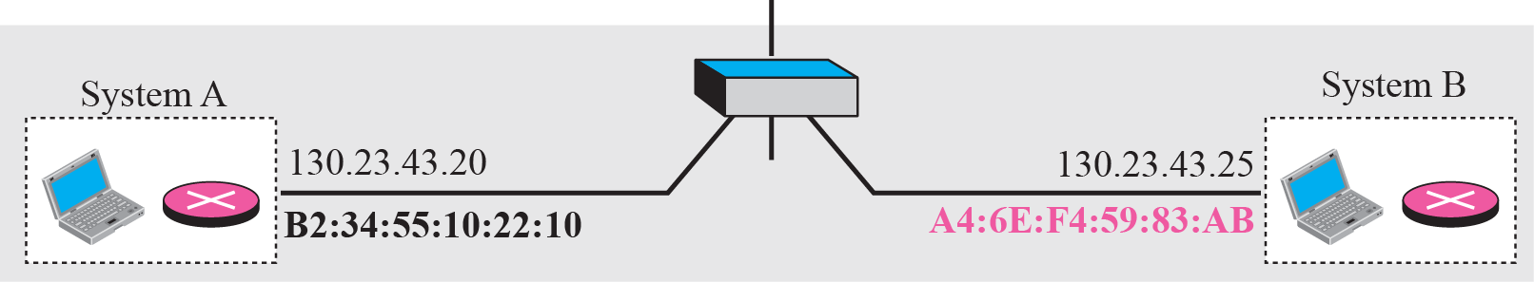
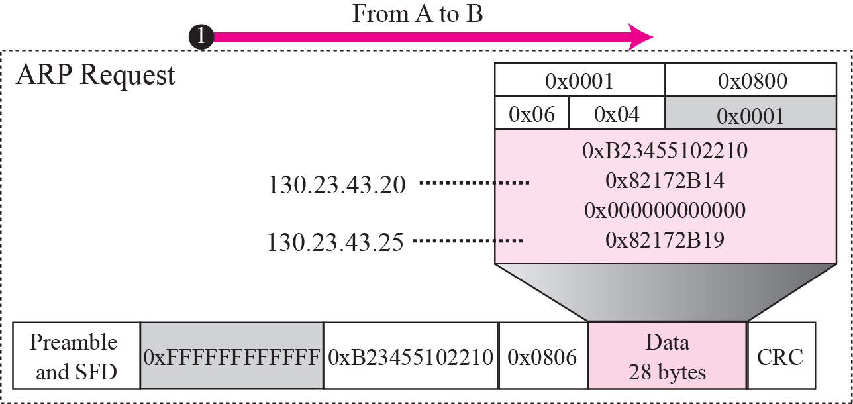
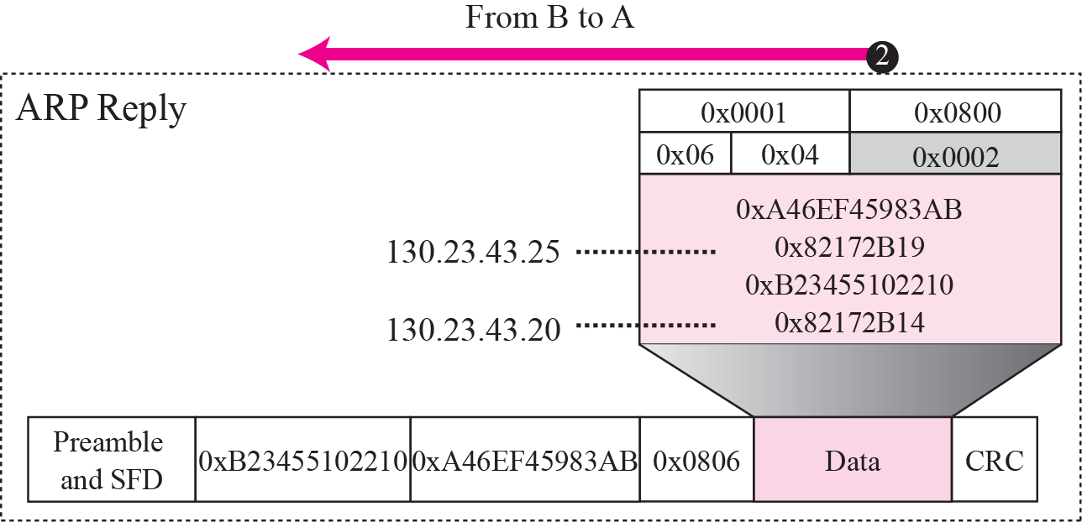
Solution

Slide 31
Proxy ARP
Used to create a subnetting effect
A router running a proxy ARP
Its ARP acts on behalf of a set of hosts
If it receives an ARP request message looking for the address of one of these host
The router sends an ARP reply announcing its own hardware (physical) address
After the router receives the actual IP packet
It sends the packet to the appropriate host or router

Slide 32
Example
As shown in the next slide
The administrator need to create a subnet without changing the whole system
Add a router running a proxy ARP

Slide 33
Figure 7-8
Proxy ARP
The McGraw-Hill Companies, Inc., 2000

Slide 34
Outline
The McGraw-Hill Companies, Inc., 2000
Address Mapping
The ARP Protocol
ATMARP (Skip!)
ARP Package (Skip!)

